Slide 1
Enhancing Robustness Against Adversarial Examples in Network Intrusion Detection Systems
Mohammad Hashemi, Eric Keller
University of Colorado Boulder
IEEE NFV-SDN 2020
Notes:
Hi everyone. My name is Mohammad Hashemi from the University of Colorado Boulder and today I want to present our paper which is about enhancing robustness against adversarial examples in network intrusion detection systems.

Slide 2
Network Attacks Are Growing
Every year there is a growth in the number of attacks, their complexity and their scale.
Wide range of impacts
High monetary cost for exploited businesses
Wide-scale power outage
Network Intrusion Detection Systems (NIDS) as a defense.
Notes:
So, we know that network attacks are growing.
Every year there is a growth in the number of attacks, their complexity and their scale.
And such attacks have a wide range of impacts from high monetary cost for exploited businesses to more serious issues such as wide scale power outages.
Network intrusion detection systems (NIDS) are one line of defense against such attacks.

Slide 3
Traditional Solution
Signature-based NIDS
Snort
Suricata
Are based on known signatures.
Known sequence of bytes
Fixed access patterns
Can’t detect zero-day attacks.
Notes:
Traditionally,
we had signature-based NIDS like Snort and Suricata
Which were capable of detecting known attacks
by looking at known signatures either a known sequence of bytes or fixed access patterns.
But the problem with these NIDS is that they can’t detect zero-day attacks because there is no known signature for them.

Slide 4
Anomaly-based NIDS
ML-based
Only trained on benign inputs.
During inference time they measure how similar a new input is to the training set.
Detect anomalies by looking for deviations from benign network traffic.
Can detect zero-day attacks.
Notes:
On the other hand, we have anomaly-based NIDS
Which are based on machine learning models such as neural networks
These NIDS are only trained on benign inputs
And during execution-time, they measure how similar a new input is to the training set.
So they detect anomalies by looking for deviations from benign network traffic.
Therefore such NIDS are capable of detecting zero-day attacks.

Slide 5
Flow-based
Builds high-level features for a whole flow
Total number of packets
Flow duration
Std of packet lengths
Total number of SYN,ACK, etc. flags
Ensemble of Autoencoders
Kitsune [Mirsky et al. ’18]
Energy in the GMM framework
DAGMM [Zong et al. ’18]
GAN
BiGAN-based [Zenati et al. ‘18]
Malicious
Feature Extractor
Anomaly Detector
Score
…
Stream of Packets
Threshold
Benign
Packet-based
Extracts features from each packet
Raw values from packet headers
IP header length
Hand-engineered features calculated based on a few packets
Notes:
So this is how an anomaly-based NIDS Looks like: These NIDS have two major components: a feature extractor and an anomaly detector
The feature extractor receives a stream of packets and extracts some features from them. They can be built in two different ways:
They can extract high-level features from a whole flow. We call NIDS which are based on these feature extractors a flow-based NIDS
They can also extract features from every single packet. We call NIDS which are based on these feature extractors a packet-based NIDS
Then the feature vectors extracted by the feature extractor are fed to the anomaly detector component
This component can also be built in several different ways as shown in previous work: like with the help of an ensemble of autoencoders or GANs or some other ways.
But at the end of the day regardless of how this anomaly detector is created for each input it calculates a similarity score and compares it against a threshold. If the score was less than the threshold it labels that input as a benign input otherwise it’ll label it as a malicious input. And the threshold is set based on the acceptable level of false alerts or false positive rate.

Slide 6
Problems with Existing Work
Evaluated on outdated datasets or datasets that don’t include different types of network attacks.
Poor performance when keeping False Positive Rate (FPR) at a low level.
Notes:
But the existing work has some problems:
The first problem is that they were evaluated on old datasets or datasets that don’t include different types of network attacks.
But when we evaluated them on a dataset with a variety of network attacks they showed very poor performance in a low false alert setting.
For example here in this graph, you can see how Kitsune which is a packet-based NIDS performs on this dataset when we have set its threshold in a way to only have a 1% false-positive rate. As you can see TPRs for most of the attacks are almost zero or pretty low in such a setting.

Slide 7
Problems with Existing Work
Vulnerable to the adversarial examples!
Transformations
Changing the delay between packets
Carry out original malicious intent
Splitting a packet
Without breaking underlying network protocols
Injecting fake packets
Fool the NIDS
[Hashemi et al. ’19]
Notes:
The second problem with the existing work is that they are vulnerable to the adversarial example attack!
In our previous work, we showed that by applying a set of transformations on the malicious traffic such as changing the IAT between packets, splitting large packets into multiple smaller packets, and injecting fake packets into the packet stream the attacker can fool the NIDS to label this malicious traffic as benign but in a way to still be able to carry out the original malicious intent of the attack without breaking the underlying network protocols

Slide 8
How to build an NIDS capable of detecting different types of network attacks in a low false alert setting with an enhanced robustness against adversarial examples?
Notes:
So in the rest of this presentation we want to see how we can build an NIDS capable of detecting different types of network attacks in a low false alert setting with an enhanced robustness against adversarial examples?

Slide 9
Problems with an Existing NIDS
Feature Extractor
Anomaly Detector
Notes:
So in order to build a better NIDS, we first want to inspect Kitsune more and see why it showed such a poor performance. So we will look into the problems that exist in its feature extractor as well as the problems with its anomaly detector

Slide 10
Extracted Features Are Designed to Detect Specific Types of Attacks
Features in Kitsune are designed in a way to detect streams in which lots of packets are sent in a short amount of time.
That is why Kitsune-AE could detect Hulk attack very well but not the other ones.
Hand engineered features designed to detect specific types of attacks contradict our initial goal to detect zero-day attacks.
Notes:
Regarding the feature extractor, we realized that the extracted features are manually designed to detect specific types of network attacks.
More specifically they are designed in a way to detect streams in which lots of packets are sent in a short amount of time.
That is why Kitsune could detect Hulk attack very well but not the other ones.
But the problem is that hand-engineered features designed to detect specific types of attacks contradict our initial goal to detect zero-day attacks.

Slide 11
Reconstruction Error Based on Full Observation Leads to Over-Generalization
Anomaly
Ideal Anomaly Detector
Score(x)
Normal
0
Notes:
Regarding the anomaly-detector, we realized that the reconstruction error of the inputs which is calculated with the help of autoencoders based on full observation of the inputs leads to an over-generalization problem!
So to understand this better we wanna first demonstrate how an ideal anomaly detector should work!
So in an ideal world, when we feed normal or benign samples to the model we like to get very small scores; something close to zero
And when we feed anomalies or malicious inputs to the model we like to get very large scores so we can observe a large gap between normal points and anomalies. This way we can easily distinguish anomalies from normal points.

Slide 12

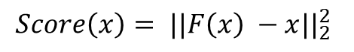
Reconstruction Error Based on Full Observation Leads to Over-Generalization
Reconstruction of the input based on full observation is too easy!
Model can reconstruct anomalies as good as normal inputs!
x
F
F(x)
$$Loss=\frac{1}{N} \sum_{i=1}^{N}{{||F\left(x_{i}\right) −x_{i}||}_{2}^{2}}$$
0
$${Score\left(x\right)= ||F\left(x\right) −x||}_{2}^{2}$$
Notes:
But it turned out that this is not the case when we use autoencoders as our anomaly detector.
So here we have an illustration of an autoencoder. It receives an input x and outputs f(x)
And we train the model with mean square error
to force it to reconstruct the same input it sees!
But the problem is that reconstruction of the input based on full observation is too easy when the model has enough capacity! Because it just approximates the identity function!
Therefore, the model learns to reconstruct anomalies as good as normal points
So when we feed a normal point to the model it reconstructs it pretty well. Therefore the score we calculate which is the reconstruction error would be pretty small.
But the same thing happens for the anomaly points. That is to say, the model will reconstruct them pretty well, too, therefore their reconstruction error would be pretty small again.

Slide 13
PROPOSED SOLUTION
Notes:
So now by understanding the problems of existing work we wanna talk about how we addressed these issues!

Slide 14
Feature Extractor
580
A packet-based feature extractor based on raw values extracted from each packet.
20
A
X
A
A
X
A
X
Will be fed to the anomaly detector
…
…
X
A
X
X
A
X
A
AX__XA
A
X
B
B
X
Y
B
Inter-arrival time
From Ethernet header
Frame length
From IP header
IP header length, IPlength, IP flags (df, mf, rb), TTL
From TCP header:
source port, destination port, sequence number, acknowledgment number, TCP flags (res, ack, cwr, ecn, fin, ns, push, reset, syn, urg), TCP window size, urgent pointer
Direction
29 features for each packet
Group by
src. & trg. IPs
…
…
X
A
Y
Y
A
B
Y
Stream of Packets
B
B
Y
B
Y
Y
B
…
Y
Y
B
Y
B
B
Y
BY__YB
Notes:
Regarding the feature extractor, instead of manual feature engineering, we decided to build a packet-based feature extractor based on raw values extracted from each packet.
More specifically, after receiving the stream of packets
We first group them based on their src and trg IPs
Then in each group from each packet, we extract 29 features which are things like inter-arrival time, some features extracted from headers like Ethernet and IP headers, and the direction of the packet
Then we consider a window with size 20 and concatenate features extracted from packets in this window to build a feature vector with 580 elements. this vector becomes one of our inputs which we feed to the anomaly detector component
Finally, we move this window one step forward to build the next feature vector and we repeat this procedure until reaching the last packet in each group!

Slide 15

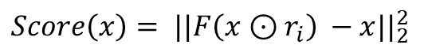
Reconstruction from Partial Observation (RePO)
A harder problem!
The model should generate the hidden parts based on what it observes.
x
F
F(x)
$$Loss=\frac{1}{N} \sum_{i=1}^{N}{{||F\left(x_{i}⊙r_{i}\right) −x_{i}||}_{2}^{2}}$$
010010…….0111011
110100…….1100010
0
$${Score\left(x\right)= ||F\left(x⊙r_{i}\right) −x||}_{2}^{2}$$
Notes:
For the anomaly detector component
we still want to use an autoencoder but instead of a vanilla autoencoder, we use a denoising autoencoder to force the model to reconstruct an input based on partial observation of it.
More specifically, we want to only feed some parts of the input into the model and force it to reconstruct the whole input again
This is essentially a harder problem
Because it’s not an identity function anymore and the model should generate the hidden parts of the input based on what it observes.
So, in practice, we train our model with the following loss function to do these things.
In this loss function, RI is a random mask consisting of 1s and 0s and we will do an elementwise multiplication between this mask and a given input before feeding it into the model
and because it is random each time it’ll mask different parts of the input
So during inference time when we feed a normal sample into the model, it’ll reconstruct it pretty well
Therefore its reconstruction error would be a low number
But when we feed an anomaly to the model, the model doesn’t know how to reconstruct its hidden parts and will fill in those parts with wrong values
Therefore its reconstruction error becomes a larger value so at the end of the day it becomes easier to distinguish between normal and anomaly points in this case. We call this method reconstruction from partial observation or just RePO

Slide 16
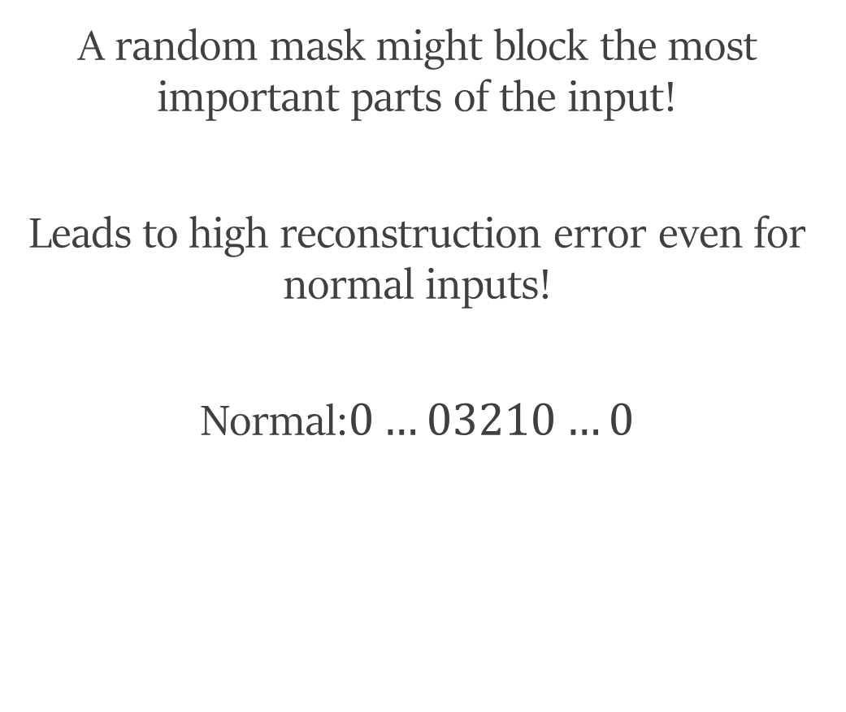
Effect of Bad Masks
A random mask might block the most important parts of the input!
Leads to high reconstruction error even for normal inputs!
Normal:$0…03210…0$
0,3,2,1,0,0,0,0
?,?,?,?,?,?,?,?
0,3,2,1,0,0,0,0
Bad Mask
F
x
F(x)
Notes:
But RePO has its own problem.
A big problem occurs when a random mask blocks the most important parts of a given input.
In this case, we would also have a high reconstruction error even for normal inputs!
So suppose that normal points look like this pattern: a few 0s, then 3,2 and 1 followed by a few other 0s.
If these parts of the input get blocked by a random mask, then the model can see 2 and 1 and it knows that every time it saw 2 and 1 during the training phase, there was a 3 before them and the other elements were zero. So it can successfully reconstruct the input
But if the random mask would look like this one, because it blocks all informative parts of the input the model can’t reconstruct it and therefore we would have a high reconstruction error, even though the input was a normal input. We refer to these masks as bad masks.

Slide 17
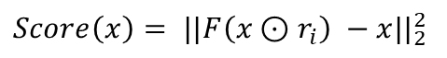
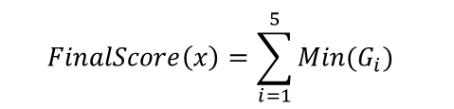
RePO+
Better distinguishment between normal and anomaly inputs
…
…
100
100
Higher detection rate!
$${Score\left(x\right)= ||F\left(x⊙r_{i}\right) −x||}_{2}^{2}$$
…
1.7
0.5
0.9
…
3.1
0.1
2.5
3.6
…
0.4
$$FinalScore\left(x\right)=\sum_{i=1}^{5}{Min(G_{i})}$$
5
2.1
1.1
0.7
…
2.4
0.9
1.5
2.5
…
0.5
5.3
3.3
1.3
1.6
Bad Mask!
20
Notes:
So in order to solve this issue, we modified RePO as follows:
Instead of feeding one instance of a given input to the model
we replicate it 100 times and multiply each of them with a different random mask
and feed all of them to the model in parallel
So the model outputs 100 different vectors and some of them are probably reconstructed better than the others.
Then we calculate the score for each case as before
And we group these scores into 5 groups, each with 20 elements.
Then in each group, we select the minimum score which is for a case that is reconstructed better
And then we add them together to construct the final score of our anomaly detector.
Using this method we essentially get rid of those cases which have high reconstruction error because of a bad mask!
Therefore we can distinguish normal and anomaly points better
Which leads to a higher detection rate! We call this method RePO+

Slide 18
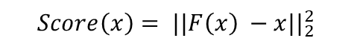
RePO+
RePO+ is also more robust against the adversarial example attack.
$${Score\left(x\right)= ||F\left(x\right) −x||}_{2}^{2}$$
Benign
Malicious
Notes:
In addition, RePO+ is more robust against the adversarial example attack compared with reconstruction from full observation!
So suppose that we wanna detect anomalies based on reconstruction from full observation
and we feed a malicious input to the model
And the model can’t reconstruct it very well
so when we calculate its reconstruction error it would be larger than the model’s threshold
and therefore would be labeled as a malicious input!
For this input, an adversary might be able to craft an adversarial example by adding some perturbations to it like this
Such that it gets reconstructed better.
Therefore its score becomes a number lower than the threshold and will fool the model!

Slide 19
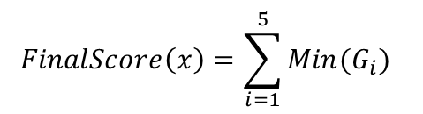
The adversary should plan to modify a larger set of features to fool the model.
RePO+
…
…
RePO+ is also more robust against the adversarial example attack.
100
100
Such changes might not be feasible!
$$FinalScore\left(x\right)=\sum_{i=1}^{5}{Min(G_{i})}$$
Benign
Malicious
The model becomes more robust against the adversarial example attack!
Notes:
But when we use the RePO+ technique,
The random masks would block all or some of the perturbations. So they'll eliminate the effect of such perturbations completely or partially.
Therefore the input’s score would become larger than the threshold again which means it can not fool the NIDS anymore.
That means that the adversary should plan to modify a larger set of features to fool the model compared to reconstruction from full observation
But such changes might not be feasible! Because for example, the adversary might not be able to find a set of transformations on the network traffic to generate those perturbed feature values!
As a result, the model becomes more robust against the adversarial example attack!

Slide 20
EVALUATION
Notes:
Finally to see how our NIDS can actually detect different types of network attacks we evaluated it on the dataset we mentioned earlier and compared it against Kitsune as they are both packet-based NIDS.

Slide 21
Packet-based NIDS in a Normal Setting
Total number of attacks detected
Kitsune-AE
RePO+
1
8
Average detection rate across all attacks
Kitsune-AE
RePO+
5.71%
34.77%
6 times better than Kitsune!
29% improvement!
Notes:
So we first evaluated them in a normal setting
and set the threshold of each NIDS in a way to only have 1% FPR.
In such a setting Kitsune could only detect one of the attacks and its average detection rate across all attacks was only 5%
In contrast, RePO+ detect 8 attacks out of 11 attacks and its average detection rate was 34%.
This means that we are 6 times better than Kitsune and
we could improve the average detection rate by 29% in a low-false alert setting.

Slide 22
Packet-based NIDS in an Adversarial Setting
Total number of attacks detected
Kitsune-GMM
5
Average detection rate across all attacks
Kitsune-GMM
16.62%
Average drop in detection rate
Kitsune-GMM
26.74%
Notes:
For evaluation in an adversarial setting
We increase the FPR to 10% because in the previous scenario Kitsune couldn’t detect most of the attacks even in a normal setting and therefore it couldn’t be evaluated in an adversarial setting at all.
So at this FPR, this is how kitsune can detect different attacks without modifying the malicious traffic adversarially.
But when we craft adversarial examples the detection rates in all the attack categories drop significantly as shown in this graph with dark blue bars.
So in this adversarial setting Kitsune could detect 5 different attacks
And the average detection rate was 16%
The average drop in its detection rates was also 26%

Slide 23
Packet-based NIDS in an Adversarial Setting
Total number of attacks detected
Kitsune-GMM
RePO+
5
10
Average detection rate across all attacks
Kitsune-GMM
RePO+
16.62%
62.07%
3.7x better
Average drop in detection rate
Kitsune-GMM
RePO+
26.74%
2.36%
11.3x better
Notes:
This is also how RePO+ can detect different network attacks without modifying the malicious traffic adversarially.
But in contrast to Kitsune, when we crafted adversarial examples against RePO+ the detection rate only dropped slightly across different attack categories as you can see it in the graph in dark green bars
So in such a setting with RePO+ we could detect 10 different network attacks out of 11 attacks
And the average detection rate was 62% which is 3.7 times better than Kitsune
Also, The average drop in the detection rate for RePO+ was only 2% which means it is 11 times better than Kitsune.

Slide 24
RePO+ can also be combined with a flow-based feature extractor!
Notes:
It is also worth to say that RePO+ can be combined with a flow-based feature extractor to build a flow-based NIDS.

Slide 25
Flow-based NIDS in a Normal Setting
Average detection rate across all attacks
DAGMM
RePO+
BiGAN
4.91%
25.49%
15.05%
5.2x better than DAGMM
1.69x better than BiGAN
Notes:
So as a flow-based NIDS when we evaluated RePO+ in a normal setting it was 5 times better than one of our baselines and 1.7 times better than the other one

Slide 26
Flow-based NIDS in an Adversarial Setting
Average detection rate across all attacks
DAGMM
RePO+
BiGAN
35.19%
47.02% (R)
35.74%
1.3x better
Notes:
Also in an adversarial setting, the average detection rate of RePO+ was 47% which is 1.3 times better than our baselines.

Slide 27
Conclusion
RePO+ can be used to build more accurate and more robust packet-based and flow-based NIDS.
In a normal setting, it can increase the average detection rate by up to 29%.
In an adversarial setting, it can increase the average detection rate by up to 45%.
Notes:
So in conclusion with the RePO+ technique, we can build a more accurate and more robust NIDS in both packet-based and flow-based contexts.
Such NIDS can increase the average detection rate in a normal setting by up to 29%
And in an adversarial setting by up to 45%.

Slide 28
Questions?
Notes:
And that’s it so let me know if you have any questions.

